Slide 1
Cardiris Corporate 5 for Microsoft Dynamics CRM
Scan your business cards directly into Microsoft Dynamics CRM

Slide 2
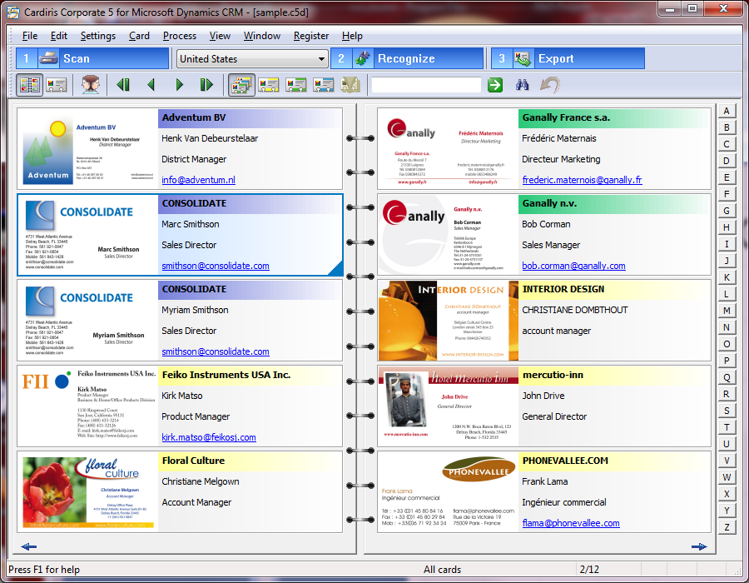
Cardiris - Overview
Cardiris is a contacts management software fed by images of business cards
Typical use of Cardiris:
Scan
Recognize, edit and organize
Export contact data to your favorite contacts manager
Cardiris supports a wide variety of scanners:
IRIS scanners (IRISCard, IRIScan)
Twain scanners
MFP’s
GUI: 19 languages (in Cardiris 5)

Slide 3
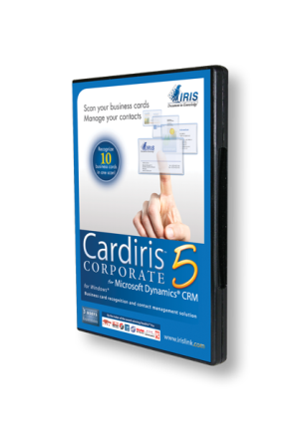
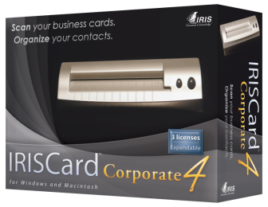
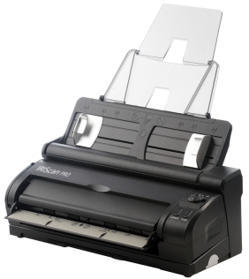
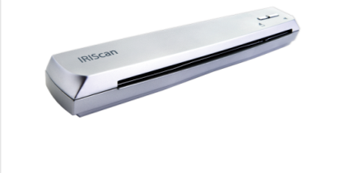
Cardiris - Branding
Currently available:
Software Cardiris (PC and Mac)
Latest developments
Cardiris 5 for PC
Bundled with various scanners
IRISCard
IRIScan
OEM (several solutions)
Business card recognition technology is also available in Readiris CE 12

Slide 4
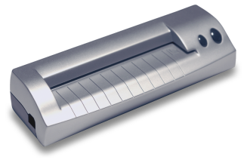
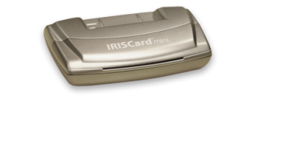
Cardiris 5 – Scanning single cards
IRIS Scanners
IRISCard
IRISCan
Duplex (software)
600 BC’s per hour
Duplex
Single card

Slide 5
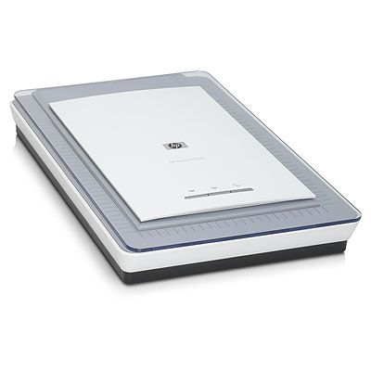
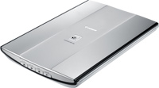
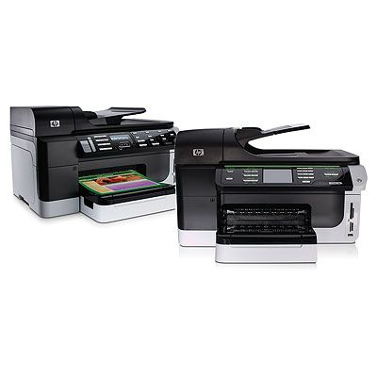
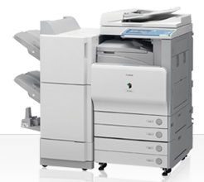
Cardiris 5 – Scanning multiple cards
Twain scanners: sheet-fed, flatbed, …
MFPs: send to folder
Cardiris’
« Extract cards » feature
Multiple cards

Slide 6
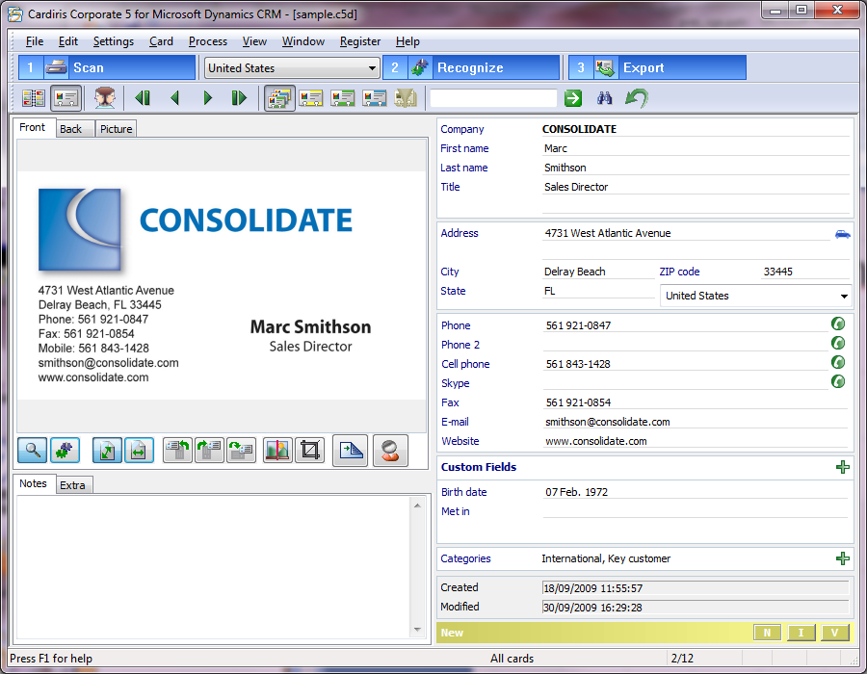
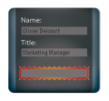
Cardiris 5 – Recognize, Organize & Edit
Regular (OCR) fields
Recognize
(218 countries)
Duplicates
Management
Up to three images
Advanced processing:
On-the-fly OCR
Drag-and-drop OCR
Image processing
Add notes (auto)
Custom fields
Categories

Slide 7
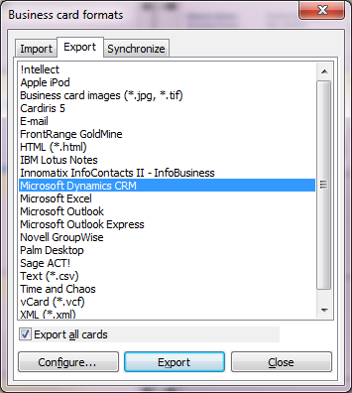
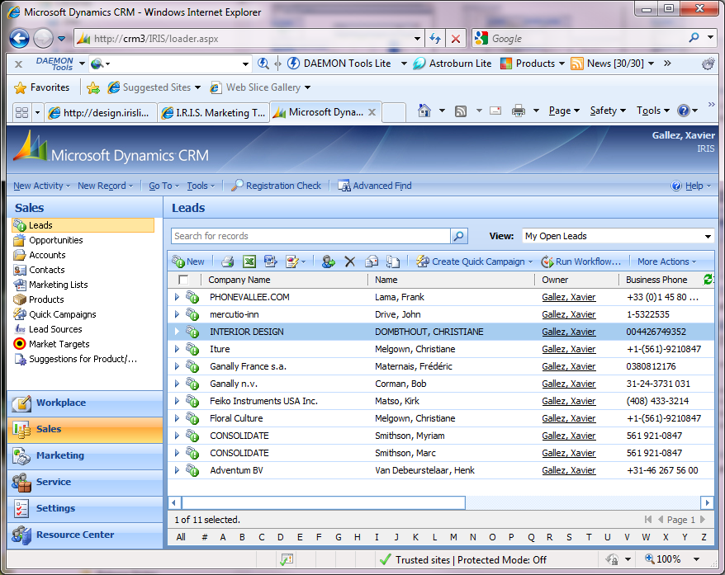
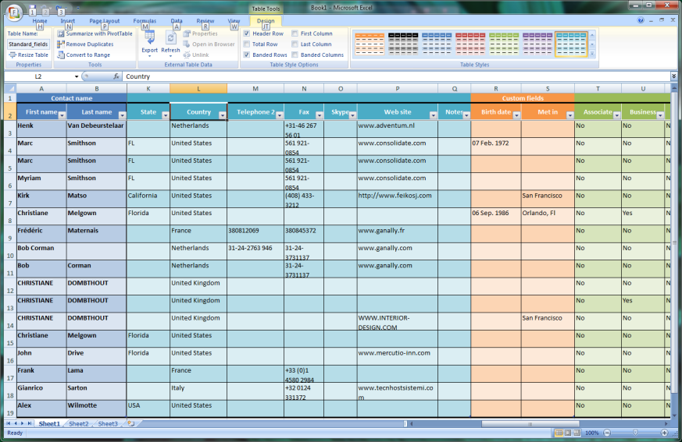
Cardiris 5 - Export

Slide 8
Cardiris 5 – Demo
Scanning single cards
Editing & organizing cards
Exporting to MS Dynamics CRM

Slide 9
CRM Export: Key Points
Export batches of cards with a few clicks
Powefull duplicate detection tool for export
Tailor to your organization, suit your needs:
Support MS CRM 3 and 4
On-premise or IFD connection modes
Flexible entity mapping (lead or contact)
Generic field mapping
Many user profiles supported
Easy deployment (single file copy)

Slide 10
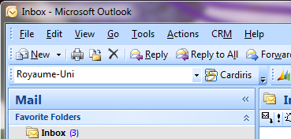
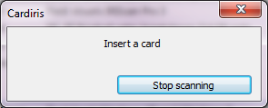
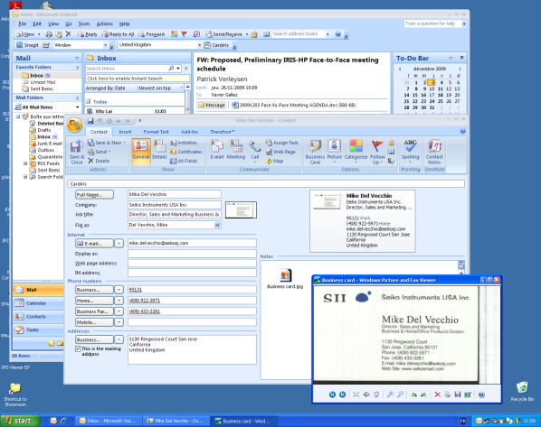
Cardiris Toolbar for MS Outlook

Slide 11
How to face your major challenge: Do more with less, while reducing your carbon footprint
No need to print your business card a hundred times nor to keep other’s business cards. Instead:
Scan with IRISCard Anywhere
Recognize
Share on your Microsoft Dynamics CRM server

Slide 12
Reference slides – Cardiris 5 screenshots

Slide 13
Cardiris 5 – Recognize, Organize & Edit
Regular (OCR) fields
Recognize
(218 countries)
Duplicates
Management
Up to three images
Advanced processing:
On-the-fly OCR
Drag-and-drop OCR
Image processing
Add notes (auto)
Custom fields
Categories

Slide 14
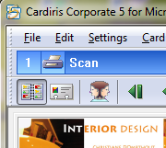
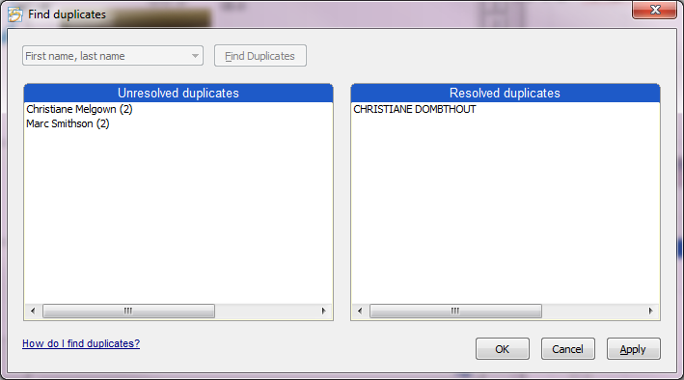
Organize & Edit: Duplicates Management Tool
Select « key » fields

Slide 15
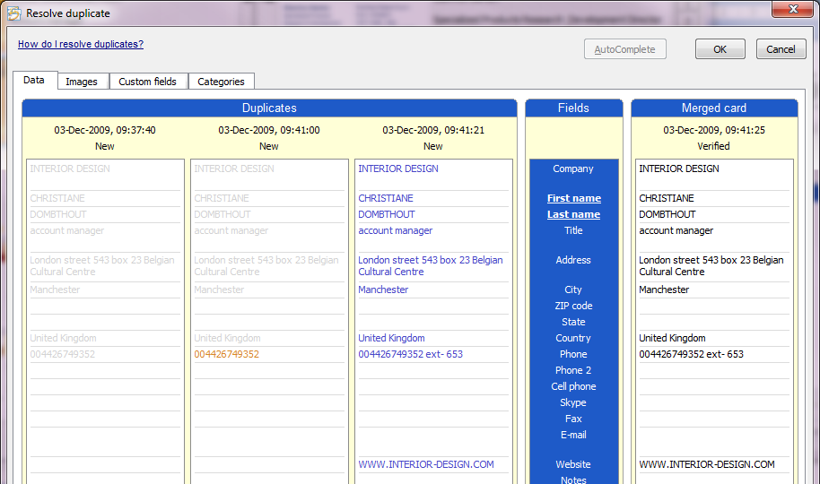
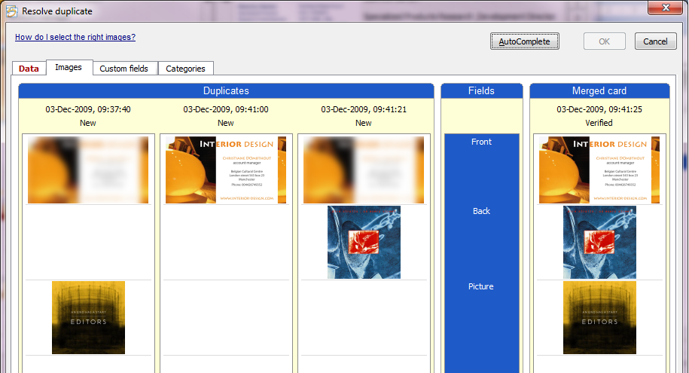
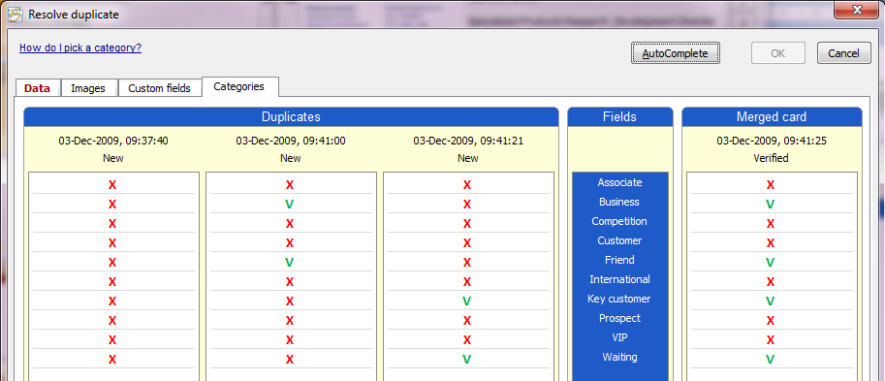
Organize & Edit: Duplicates Management Tool

Slide 16
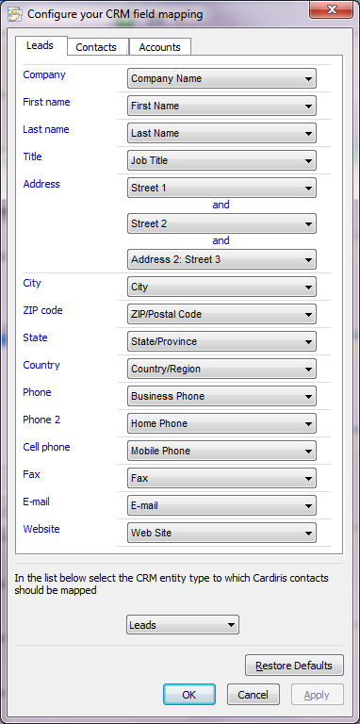
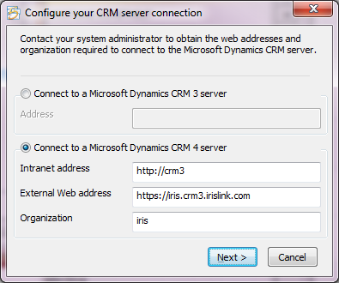
CRM Export: for your Needs
2
1
On premise
Internet Facing Deployment

Slide 17
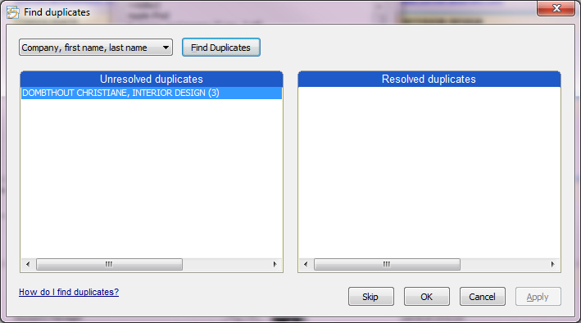
CRM Export: Duplicates Management

Slide 18
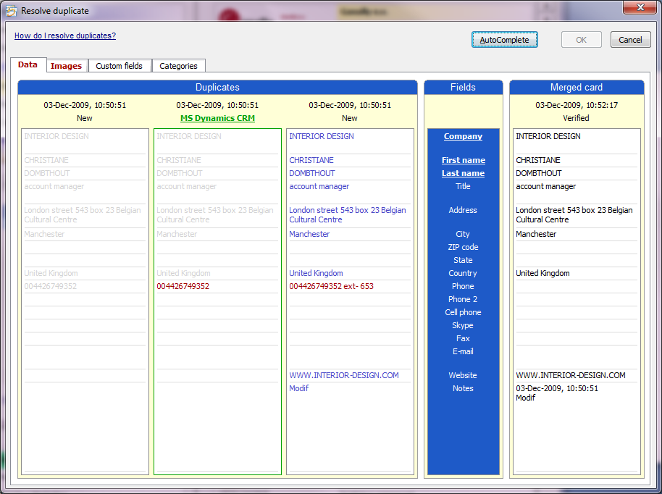
CRM Export: Duplicates Management

Slide 19
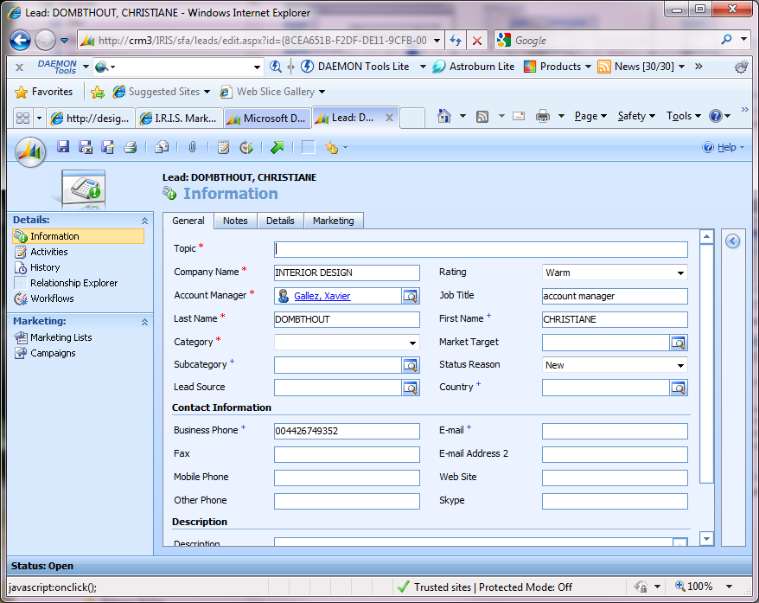
CRM Export

