Slide 1


The integration of ECM solutions in Websites for communication purpose towards the European Citizens
Speakers : Brigitte NISET (I.R.I.S.) and Frédéric Vanderheyde (JWT/Tagora)

Slide 2
Agenda
The Treaties of Maastricht & Lisbon and the commitment for transparency towards the European Citizens
Websites for information dissemination:
  Historical background: Europa and other Websites
  Challenges to face in the coming years
Websites within a global communication concept:
  Mains aspects to be taken into account
  Specificity of the I.R.I.S. / JWT association.

Slide 3
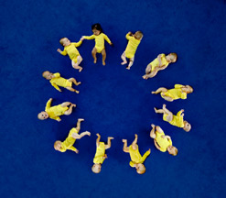

The Treaty of Maastricht
The Treaty on European Union (Maastricht) entered into force on 1st November 1993.
It has got five key goals:
  To strengthen the democratic legitimacy of the institutions
  To improve their effectiveness
  To establish an economic and monetary union
  To develop the Community’s social dimension
  To establish a common foreign and security policy.

Slide 4
The Treaty of Lisbon
The Treaty of Lisbon entered into force on
1st December 2009.
It provides the EU with modern Institutions and optimised working methods to tackle both efficiently and effectively the challenges of today's world.
It reinforces democracy in the EU and its capacity to promote the interests of the citizens.
It aims at a more democratic and transparent Europe.

Slide 5
Historical background of the European Websites
European Institutions were among the first
International Organisations to have a Website.
Now accessible through the portal: ww.ec.europa.eu,
the European Commission Website gives access to several other ones:
Parliament Council Presidency Commission Court of Justice Court of Auditors Economic and Social Committee Committee of the Regions Investment Bank Investment Fund | Central Bank Ombudsman European Data Protection Supervisor Publications Office of the European Union European Personnel Selection Office European Administrative School Agencies of the EU

Slide 6
The Europa Website: some history
The EUROPA Website was launched in February 1995 at the G7 ministerial meeting … and quickly became the main reference point for information on the EU and on its activities and policies.
In 2001, the Commission adopted the EUROPA II Communication, which gave the Internet a central place in communication activities, under the
e-Commission programme.
Source : http://ec.europa.eu/dgs/communication/pdf/internet-strategy_en.pdf

Slide 7
Objectives of the Europa Website
To respond to the needs of people with a broad and/or professional interest in EU affairs
To help people looking for a particular service, or for information on their rights or on EU policies
To communicate the views of the Commission to the widest possible audience
To allow people to express and exchange their views and opinions throughout Europe
To help creating a sense of European community as a supplement to the national sphere.

Slide 8
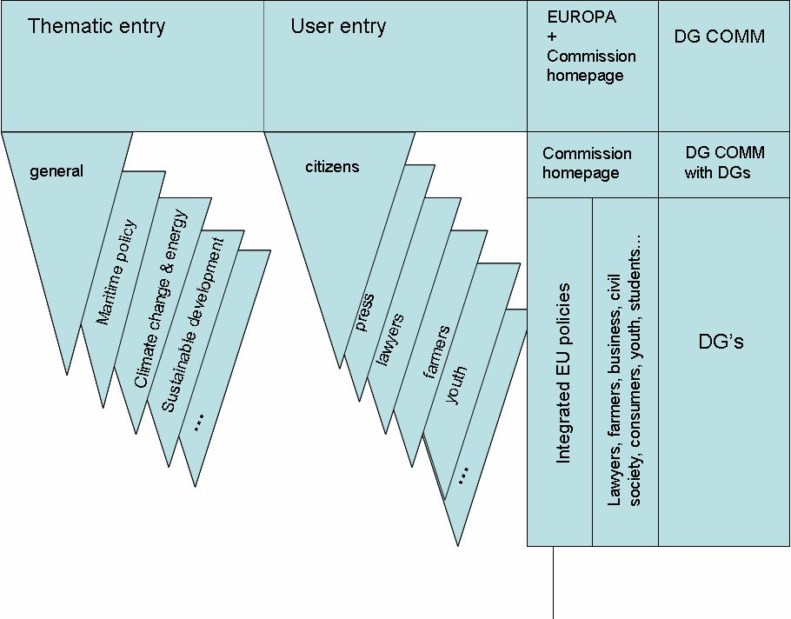
Structure of Europa Website

Slide 9
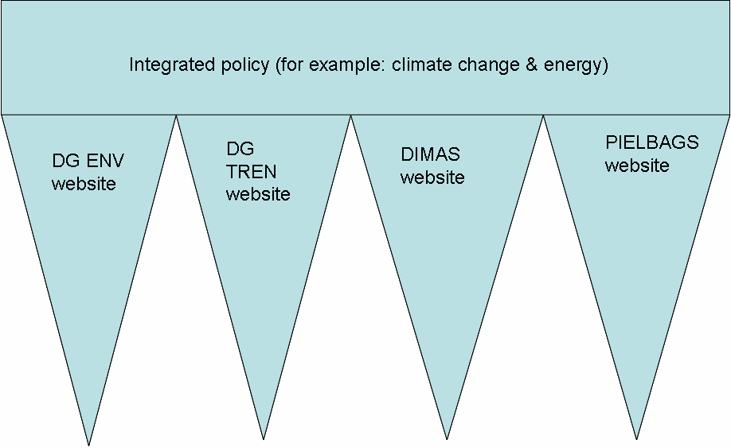
Europa Website: one example of integrated policy information

Slide 10
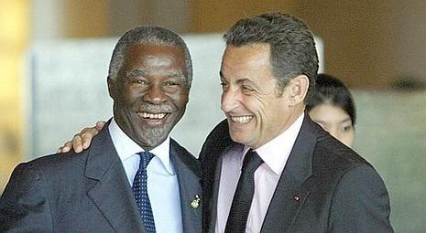
Other - event-driven - Websites
The European Institutions do also manage « event-driven » Websites, oriented to collaboration and exchange of information.
One such example is the Africa-EU partnership Website, which was created, managed and hosted by I.R.I.S.
http://www.africa-eu-partnership.org/index_en.php

Slide 11

« Theme oriented » Websites
Many Websites are dedicated to a theme managed by the European Institutions.
Example: the European Public Health Website:
http://ec.europa.eu/health-eu/index_en.htm

Slide 12


Current challenges of the European Websites
The EUROPA site is not sufficiently well-known by the European Citizens.
The EUROPA site remains overly confined to large-scale one-way information dissemination, despite:
  Debate Europe
  (europa.eu/debateeurope/index_fr.htm)
  EUTube (http://www.youtube.com/results?search_query=eutube&search_type=&aq=f)
  Information networks, like Europe Direct (http://ec.europa.eu/europedirect/index_fr.htm)
Needs to address governance, editorial content and quality and technical support and development.

Slide 13
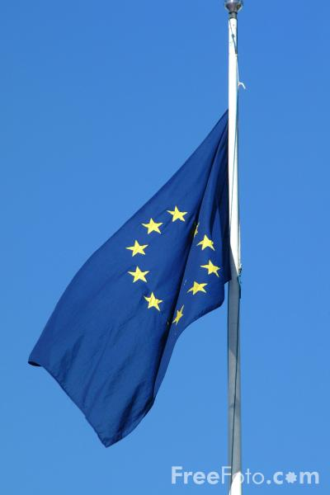
The Commission’s actions to improve Europa
Europa Steering Committee (External Communication Network), chaired by DG COMM
  Single Corporate Identity (new IPG , following the WAI recommendations)
    To address many types of users from the simple Citizen to the Professionals, from the Youth to the Elderly, from the Latins to the Nordics …
  A Europa editor following the day-to-day activities of the portal, relayed by the Internet Editor in each DG and the Editorial Committee.
A technical committee (made of representatives of DG COMM, Publications Office, INFSO, SCIC, DGT), managing the technical specificities
Notes:
SCIC =?

Slide 14
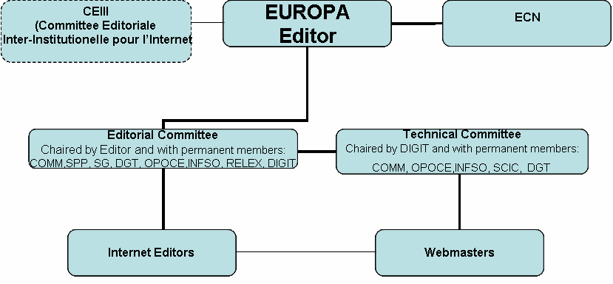

The Commission’s actions to improve the EUROPA Committee

Slide 15
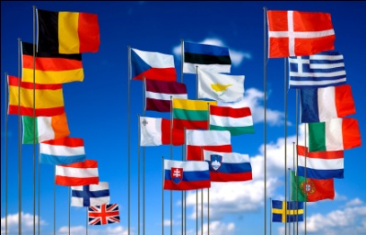
Future challenges of the
European Websites
Functional
  Restructuring and cleaning of the EUROPA site
  Multilingualism and translation
  Increased interactivity
  Bridges with other tools and mainly the Intranet Portal.
Technical
  CWCMS: specific tool based on Documentum to facilitate the creation and update of multinlingual Websites (the « Internet tool box »).
  Implementation of a powerful search engine, similar to Google, for instance.
  Integration with MS SharePoint (the tool used for the Intranet Portal).

Slide 16

And beyond the
Europa Websites
Integration of newspapers, press releases (e.g. RAPID).
Integration of TV channels (integration of EuTube in YouTube).
Pinpointing leading Websites with a focus on European affairs.
Increasing debates and monitoring of European Trends.
Participation of the Commission in blogs and online debates.

Slide 17

The I.R.I.S. views on the main challenges of Web Content Management: the Web evolution
Internet Reputation Management
  Process of tracking and responding to threats and opportunities related to online image affected by traditional and social media.
Individual-Centric Web Strategies
  A cohesive approach to ensuring that a Website is intuitive to the
  visitor of that site, placing the person at the centre of the relations.
Web 2.0: Participation and Real time
  Participation: Connection under Web 2.0 involves people in
  Web-based communities, hosted services and Web applications.
  Real time: The trend (especially for the Y generation) is to be
  connected any time, mixing business activities and private life.
Beyond Web 2.0
  Web 3.0 (Semantic Web) will connect knowledge world-wide using
  semantic search, topic trees, and personal assistants.

Slide 18
The I.R.I.S. views on the main challenges of Web Content Management: Technical evolution
SaaS
  Evolution of the application service provider (ASP) or hosted model which is particularly developing in the WCM sphere where such models are familiar.
Further development of federated search
  Major WMC/ECM vendors are developing federated search options which aggregate the results of a user-initiated search and present those results back to the user.
Greater interoperability
  WCM will be based on multiple platforms and will work with rich clients that support offline processing and high interaction with the hosting system.
Open Source WCM
  Emergence of Open Source solutions
Security and private clouds
  The element of trust will be technically and maybe covertly challenged by the security requirements from the national and international security authorities, to curb down international criminality and terrorism.

Slide 19
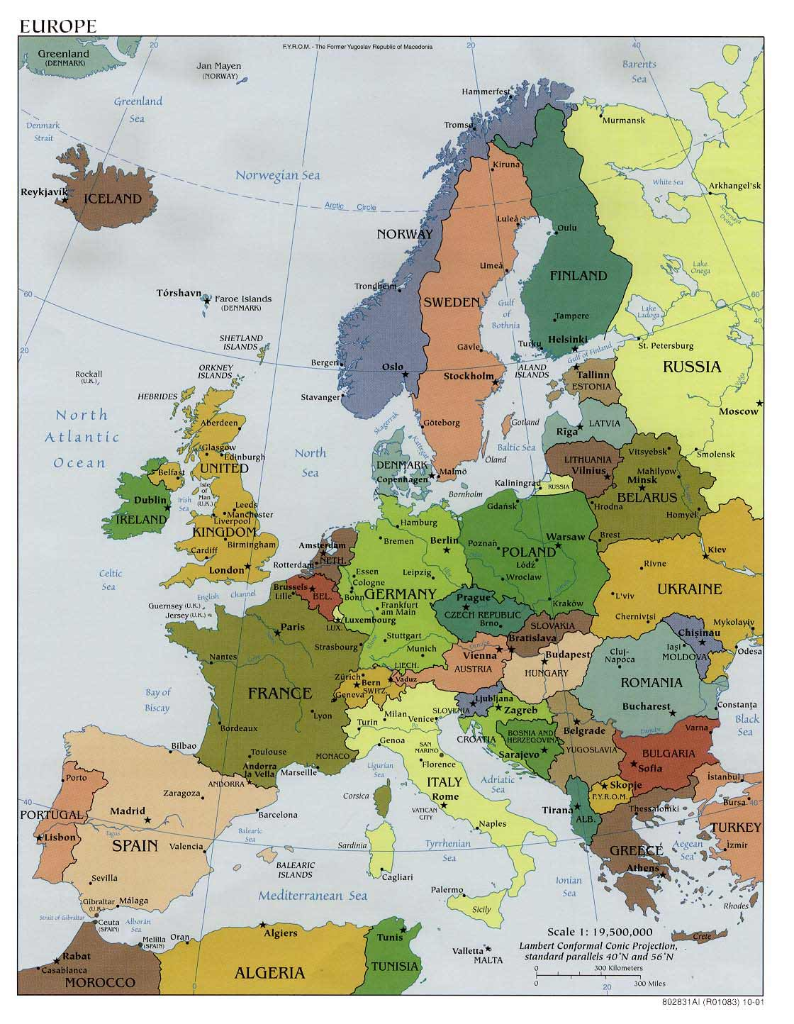
And the other Institutions ?
European Parliament:
  www.ec.europarl.eu
European Council:
  www.consilium.europa.eu
European Court of Justice:
  www.curia.europa.eu
European Investment Bank:
  www.eib.org

Slide 20
The Websites within a global communication concept: main aspects to be taken into account
Information products
  Mean all written, electronic, audiovisual or purely visual tools designed to inform a pre-determined target group about the activities, achievements and plans of DGs or Agencies.
Audiovisual services
  Preparing, producing and distributing audiovisual information products for specific audiences or the general public.
Communication campaigns and events
IT services: Websites described here above.

Slide 21
Information products
Writing text and copy for base versions of the information products
Production of language versions of base text
Identifying, designing, planning and drafting information products for use in publicity campaigns
Writing advertisements, reports, press articles and interviews
Drafting and following up promotional and presentational material (slides, speakers' kits, information packs, etc.)
Graphic design, image research, illustrations, layout, production of electronic files
Adapting all the above products with a view to putting those on Websites and/or electronic media
Photo-reportage and libraries.

Slide 22
Audio-visual services
Reportages, documentaries, video news releases, spots, video clips, animated films, etc.
Developing an online photo library
Helping to identify target groups and their needs
Advising the European Commission on its communication strategy vis-a-vis television channels and radio stations and the various target groups
Promoting products, including EBS (Europe by Satellite), to television channels and/or radio stations, with a view to free distribution
Identifying targets, such as journalists or TV/radio producers who are interested in the activities of the European Union
Securing coverage of events by the broadcast media
Monitoring the impact of EU activities in the broadcast media, particularly, but not exclusively, in the field of development.

Slide 23
Communication campaigns
Organising Commission’s participation in events (such as symposia, public events, conferences, festivals, etc.) and performing any task associated with organisation and logistics, as well as ensuring the awareness of the media and specific information networks
Organising conferences, exhibitions or public relations activities
Creating and producing fact files for participants in the events
Evaluating these events in operational terms and in terms of impact and media coverage
Organising press conferences and/or assignments for journalists
Preparing, printing and sending out press releases or press packs.

Slide 24

Websites within a global communication concept: the I.R.I.S. / JWT partnership
In order to be able to address all communication needs,
I.R.I.S. has set up a long-term partnership with JWT

Slide 25
JWT views on the main opportunities the Web has to offer to the EU
  Develop RSS-flows to provide timely information to the users
    Transform static content into information flows to which the user can subscribe.
  User-Centric Webpages:
    Use Ajax technologies to allow each user to create a personalised view on the information pages, to use content widgets and content syndication. Let the user be in charge of what he sees and when he sees it.
  Leverage Social Media to increase share of voice:
    Some subjects can be used to create Facebook applications, fan pages, Delicious bookmark libraries or LinkedIn groups. Moderated or non moderated forums can create a debate between the EU and its citizens.
  Use Search engine advertising to bring new user to your pages:
    Search engine advertising, link exchange, Search Engine Optimisation are very cost effective ways to bring “niche” topics to the Internet user. They are keyword based so they can be targeted to very specific individuals.

Slide 26


Slide 27
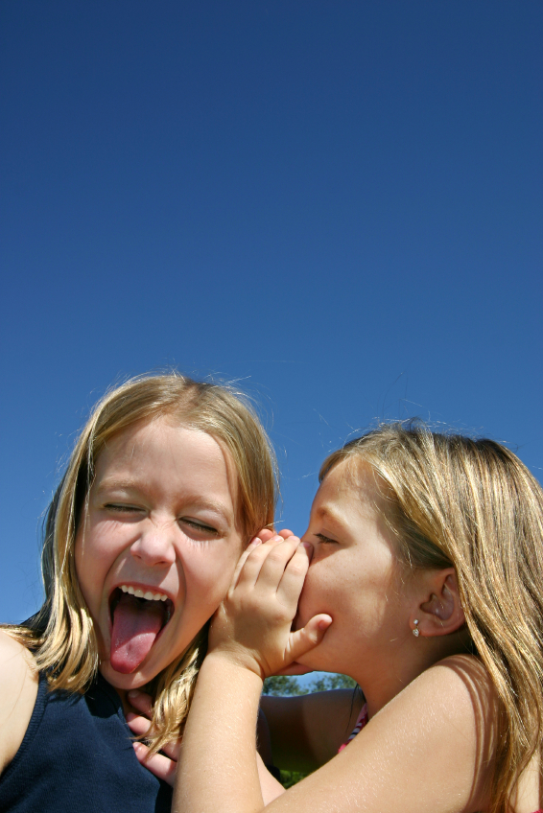
We believe in dialogue

Slide 28
How can we build a dialogue between the EU and its citizens?

Slide 30
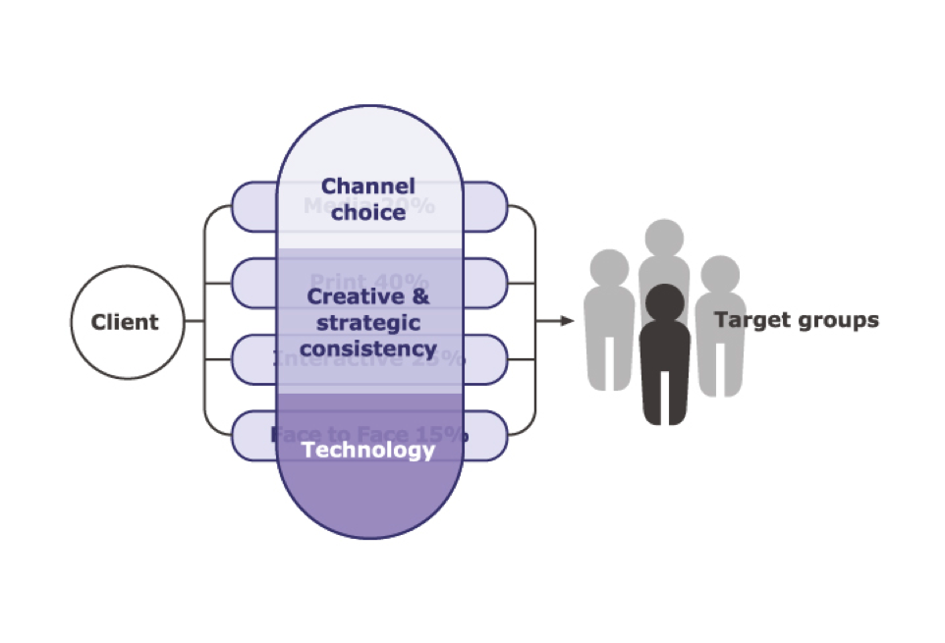
Notes:
One can read what is under the current text …

Slide 31
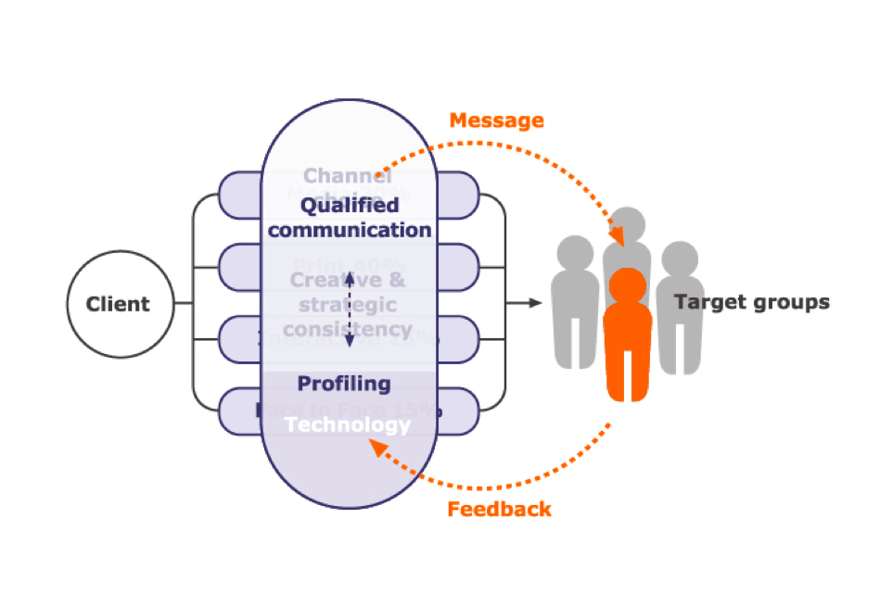

Slide 32


How to face your major challenge:
Do more with less, while reducing your carbon footprint
Paper dissemination and copy reduction
Reduction of the time needed to find the information
Reduction of travel costs to the European libraries or archives
Better information on the ecological goals of the EU Institutions.

Slide 33

Be the first to guess what is hidden under this bar-code and win an genuine IRISNotes !

Slide 34

Questions and Answers

